Slide 1
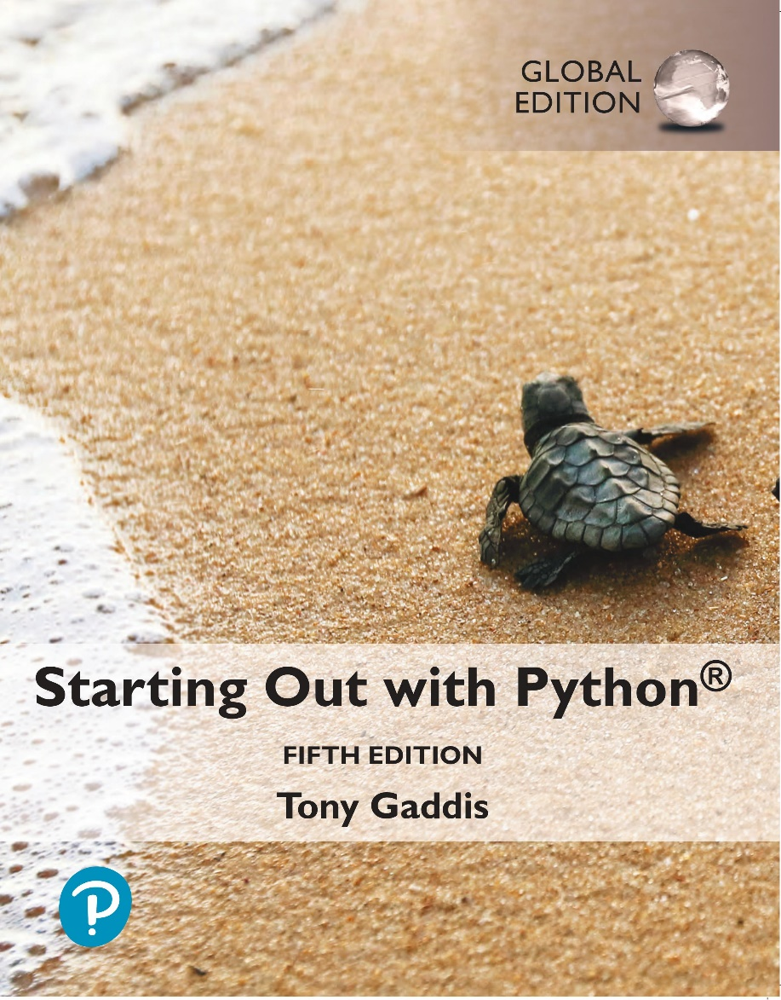
Starting out with Python
Fifth Edition, Global Edition
Chapter 5
Functions
Copyright © 2022 Pearson Education, Ltd. All Rights Reserved.

Slide 2
Topics
Local Variables
Passing Arguments to Functions
Global Variables and Global Constants
The math Module
Storing Functions in Modules

Slide 3
Local Variables (1 of 3)
Local variable: variable that is assigned a value inside a function
  Belongs to the function in which it was created
    Only statements inside that function can access it, error will occur if another function tries to access the variable
Scope: the part of a program in which a variable may be accessed
  For local variable: function in which created

Slide 4
Local Variables (2 of 3)
Local variable cannot be accessed by statements inside its function which precede its creation
Different functions may have local variables with the same name
  Each function does not see the other function’s local variables, so no confusion

Slide 5
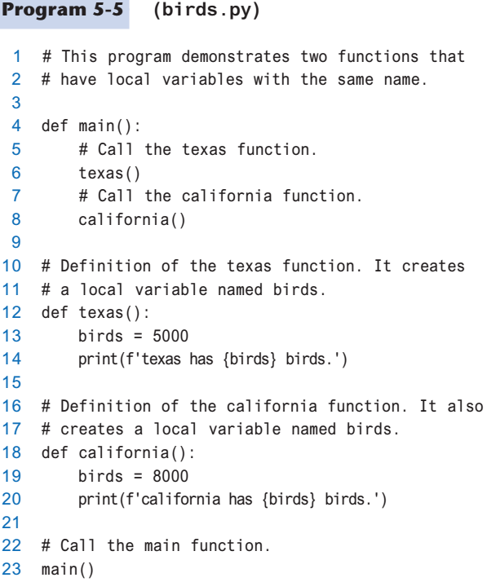
Local Variables (3 of 3)

Slide 6
Passing Arguments to Functions (1 of 4)
Argument: piece of data that is sent into a function
  Function can use argument in calculations
  When calling the function, the argument is placed in parentheses following the function name

Slide 7
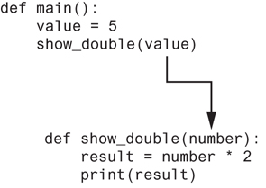
Passing Arguments to Functions (2 of 4)
Figure 5-13 The value variable is passed as an argument

Slide 8
Passing Arguments to Functions (3 of 4)
Parameter variable: variable that is assigned the value of an argument when the function is called
  The parameter and the argument reference the same value
  General format:
  def function_name(parameter):
  Scope of a parameter: the function in which the parameter is used

Slide 9
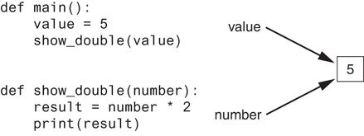
Passing Arguments to Functions (4 of 4)
Figure 5-14 The value variable and the number parameter reference the same value

Slide 10
Passing Multiple Arguments (1 of 2)
Python allows writing a function that accepts multiple arguments
  Parameter list replaces single parameter
    Parameter list items separated by comma
Arguments are passed by position to corresponding parameters
  First parameter receives value of first argument, second parameter receives value of second argument, etc.

Slide 11
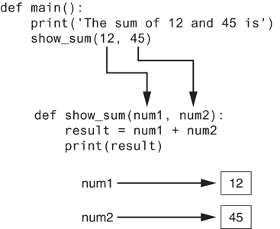
Passing Multiple Arguments (2 of 2)
Figure 5-16 Two arguments passed to two parameters

Slide 12
Making Changes to Parameters (1 of 3)
Changes made to a parameter value within the function do not affect the argument
  Known as pass by value
  Provides a way for unidirectional communication between one function and another function
    Calling function can communicate with called function

Slide 13
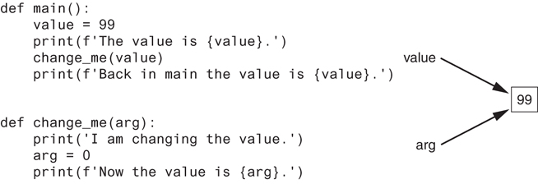
Making Changes to Parameters (2 of 3)
Figure 5-17 The value variable is passed to the change_me function

Slide 14
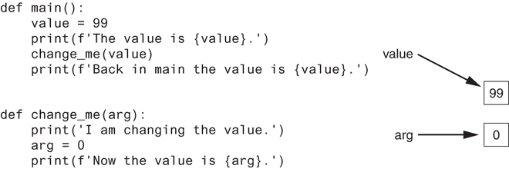
Making Changes to Parameters (3 of 3)
Figure 5-18
  The value variable passed to the change_me function cannot be changed by it
Figure 5-18 The value variable is passed to the change_me function

Slide 15
Keyword Arguments (1 of 3)
Keyword argument: argument that specifies which parameter the value should be passed to
  Position when calling function is irrelevant
  General Format:
  function_name(parameter=value)

Slide 16
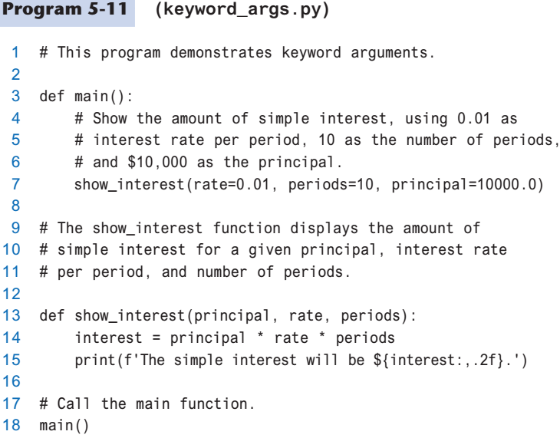
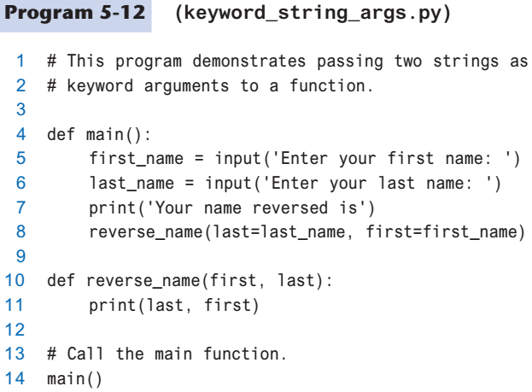
Keyword Arguments (2 of 3)

Slide 17

Keyword Arguments (3 of 3)
Possible to mix keyword and positional arguments when calling a function
  Positional arguments must appear first

Slide 18
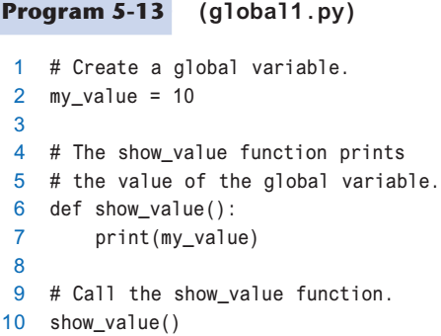
Global Variables and Global Constants (1 of 3)
Global variable: created by assignment statement written outside all the functions
  Can be accessed by any statement in the program file, including from within a function

Slide 19
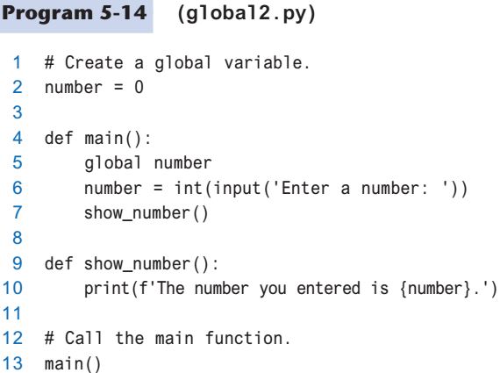
Global Variables and Global Constants (2 of 3)
Global variable: created by assignment statement written outside all the functions
  If a function needs to assign a value to the global variable, the global variable must be redeclared within the function
    General format: global variable_name

Slide 20
Global Variables and Global Constants (3 of 3)
Reasons to avoid using global variables:
  Global variables making debugging difficult
    Many locations in the code could be causing a wrong variable value
  Functions that use global variables are usually dependent on those variables
    Makes function hard to transfer to another program
  Global variables make a program hard to understand

Slide 21
Global Constants
Global constant: global name that references a value that cannot be changed
  Permissible to use global constants in a program
  To simulate global constant in Python, create global variable and do not re-declare it within functions

Slide 22
Generating Random Numbers (1 of 5)
Random number are useful in a lot of programming tasks
random module: includes library functions for working with random numbers
Dot notation: notation for calling a function belonging to a module
  Format: module_name.function_name()

Slide 23
Generating Random Numbers (2 of 5)
randint function: generates a random number in the range provided by the arguments
  Returns the random number to part of program that called the function
  Returned integer can be used anywhere that an integer would be used
  You can experiment with the function in interactive mode

Slide 24
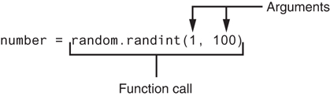
Generating Random Numbers (3 of 5)
Figure 5-20 A statement that calls the random function

Slide 25
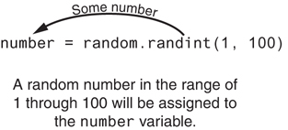
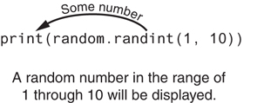
Generating Random Numbers (4 of 5)
Figure 5-21 The random function returns a value
Figure 5-22 Displaying a random number

Slide 26
Generating Random Numbers (5 of 5)
randrange function: similar to range function, but returns randomly selected integer from the resulting sequence
  Same arguments as for the range function
random function: returns a random float in the range of 0.0 and 1.0
  Does not receive arguments
uniform function: returns a random float but allows user to specify range

Slide 27
Random Number Seeds
Random number created by functions in random module are actually pseudo-random numbers
Seed value: initializes the formula that generates random numbers
  Need to use different seeds in order to get different series of random numbers
    By default uses system time for seed
    Can use random.seed() function to specify desired seed value

Slide 28
The math Module (1 of 3)
math module: part of standard library that contains functions that are useful for performing mathematical calculations
  Typically accept one or more values as arguments, perform mathematical operation, and return the result
  Use of module requires an import math statement

Slide 29
The math Module (2 of 3)
Table 5-2 Many of the functions in the math module
math Module Function | Description
acos(x) | Returns the arc cosine of x, in radians.
asin(x) | Returns the arc sine of x, in radians.
atan(x) | Returns the arc tangent of x, in radians.
ceil(x) | Returns the smallest integer that is greater than or equal to x.
cos(x) | Returns the cosine of x in radians.
degrees(x) | Assuming x is an angle in radians, the function returns the angle converted to degrees.
exp(x) | Returns e^{x}
floor(x) | Returns the largest integer that is less than or equal to x.
hypot(x, y) | Returns the length of a hypotenuse that extends from (0, 0) to (x, y).
log(x) | Returns the natural logarithm of x.
log10(x) | Returns the base-10 logarithm of x.
radians(x) | Assuming x is an angle in degrees, the function returns the angle converted to radians.
sin(x) | Returns the sine of x in radians.
sqrt(x) | Returns the square root of x.
tan(x) | Returns the tangent of x in radians.

Slide 30
The math Module (3 of 3)
The math module defines variables pi and e, which are assigned the mathematical values for pi and e
  Can be used in equations that require these values, to get more accurate results
Variables must also be called using the dot notation
  Example:
  circle_area = math.pi * radius**2

Slide 31
Storing Functions in Modules (1 of 2)
In large, complex programs, it is important to keep code organized
Modularization: grouping related functions in modules
  Makes program easier to understand, test, and maintain
  Make it easier to reuse code for multiple different programs
    Import the module containing the required function to each program that needs it

Slide 32
Storing Functions in Modules (2 of 2)
Module is a file that contains Python code
  Contains function definition but does not contain calls to the functions
    Importing programs will call the functions
Rules for module names:
  File name should end in .py
  Cannot be the same as a Python keyword
Import module using import statement

Slide 33
Summary
This chapter covered:
  Use of local variables and their scope
  Syntax and limitations of passing arguments to functions
  Global variables, global constants, and their advantages and disadvantages
  Modules, including:
    The random and math modules
    Grouping your own functions in modules

